Slide 1
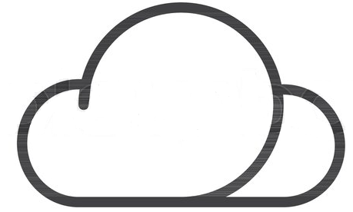
Bank & Cloud
Is the Bank and Cloud connection an oxymoron?
Iveta Šťavinová iveta_stavinova@tatrabanka.sk, +421 910 871 330 24.10.2019

Slide 2
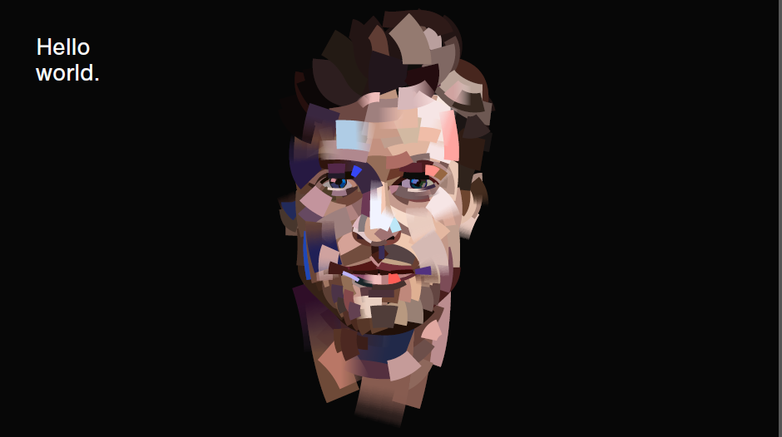
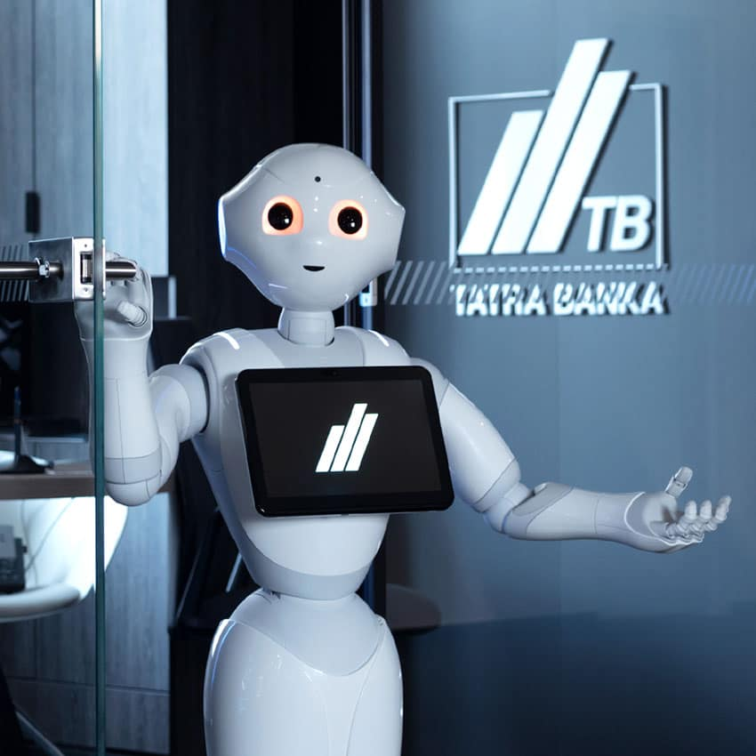
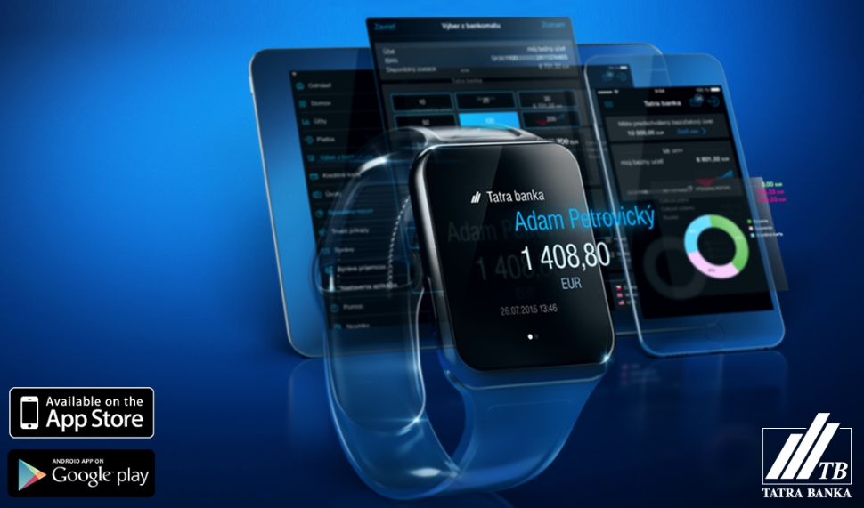
25 rokov inovácií v Tatra banka, a.s.
Inovácie v našej DNA
Biznis inovácie
DIALOG
Hlasová biometria
Karty
MobilPay
Online založenie účtu
Tvárová biometria
Mobilné aplikácie
Tatrabanka, Viamo
Pobočky
Pepper
Songoroo
Chatbot
Adam
Notes:
Od Global Finance sme tento rok už po 17. raz získali aj ocenenie Best Bank in Slovakia a okrem toho aj cenu Best Digital Bank in Slovakia.

Slide 3
agenda
What is the Cloud
IT Cloud Security Requirements
Security Risks
What is the Cloud (vocabulary setup)
IT Cloud Security Requirements
Security Risks

Slide 4
cloud definition IT world
"cloud computing is a model for
enabling ubiquitous, convenient, on-demand network
access to a shared pool of configurable computing resources
(e.g., networks, servers, storage, applications and services)
that can be rapidly provisioned and released
with minimal management effort or service provider interaction."
resource: NIST
"cloud computing is a model for
enabling ubiquitous, convenient, on-demand network
access to a shared pool of configurable computing resources
(e.g., networks, servers, storage, applications and services)
that can be rapidly provisioned and released
with minimal management effort or service provider interaction."
resource: NIST

Slide 5
Deployment models summary
Public
private
hybrid
public
Hybrid
Private
On-Premise
deployment model have direct impact to possible benefits or disadvantages
financial (economy of scale)
go-to-market (speed)
security (might be higher)
legal

Slide 6
Service models usage scenarios summary
Servis Model | Consumer | Provider
Software as a Service | Use application / service to operate business process | Install, management, service, support of sw. applications in the cloud infrastructure
Platform as a Service | Develop, test, deploy and manage applications hosted in the cloud system | Providing and management of cloud infrastructure, backend and middleware for consumers; also providing tools for development, deployment and management
Infrastructure as a Service | Install, manage, monitor IT services operation or infrastructure | Providing operation of physical infrastructure, storages, network (hosting of cloud infrastructure and environment)

Slide 7
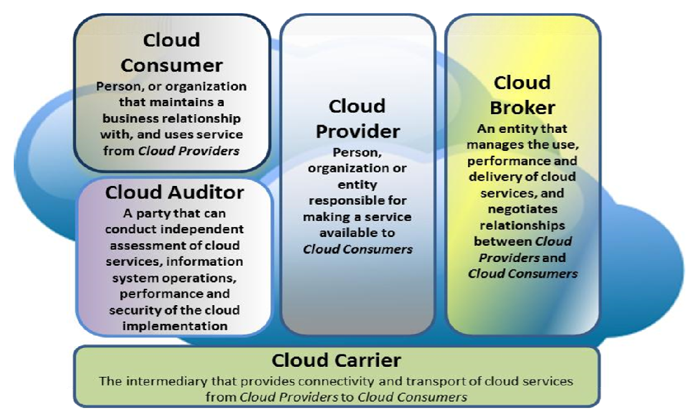
cloud-as-a-service attributes coming from definition
1
"cloud computing is a model for
enabling ubiquitous, convenient, on-demand network
access to a shared pool of configurable computing resources
(e.g., networks, servers, storage, applications and services)
that can be rapidly provisioned and released
with minimal management effort or service provider interaction."
3
2
4
5
 | public cloud | hybrid cloud | private cloud
model | standardized | specific | custom
accessibility | easy to access | requires time | takes time
resource | on-demand | reservation/plan | plan
go-to market | quick / cheap | appropriate price | appropriate price
effort | minimal | some | work
1
2
3
4
5
common components
carrier (internet, leased or private network)
cloud service provider
customer / consumer
audit / control (performance, operations, service quality, security, lawfulness, audit …)
cloud broker (managed services provider)

Slide 8
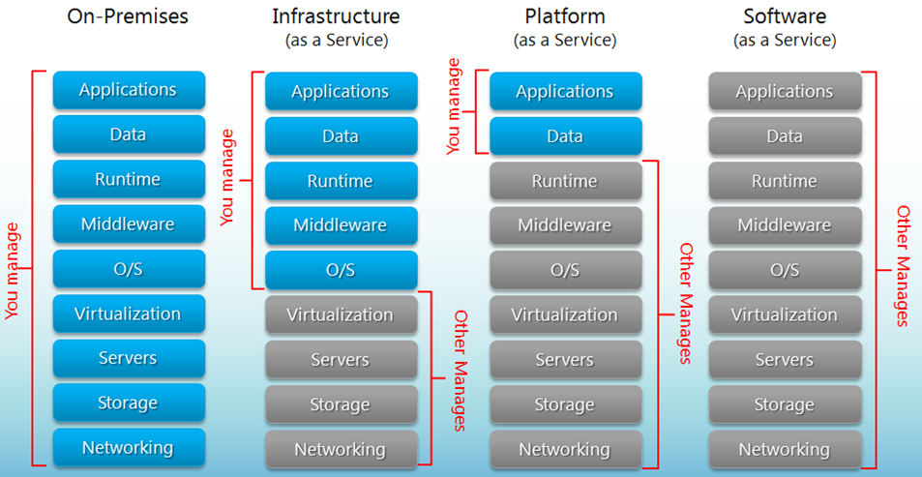
Service models shared responsibility model for: operation / consummation / security

Slide 9
Cloud summary of basic characteristics
multi-tenancy – supplier serves multiple customers (single tenant multi user)
self-service – client orders services using self service portal, services are standardized, client can setup his set of cervices by himself
on-demand – client can switch the services on/off or initiate them as he need / requires
access from any-where (typically from the internet)
resource pooling – pool of the resources, resources dynamically assigned and reassigned according to consumer demand
rapid elasticity – capabilities can be elastically provisioned and released, in some cases automatically, according to consumer demand
metering – optimization, control and charging is based on real usage of the services

Slide 10
agenda
What is the Cloud
IT Cloud Security Requirements
Security Risks

Slide 11
Regulators recommendations EBA (Recommendations on outsourcing to cloud service providers)
Risk analysis
Data location, data processing
Security of data and systems
Controls implementation
confidentiality, continuity of the service, quality, performance
protection based on data sensitivity level - keep integrity, traceability, secure data in transit/ in memory/ at rest (encryption, key management architecture)
BCM and EXIT strategy
Access and Audit rights arranged and agreed

Slide 12
Regulators recommendations NBS (Methodical guidance 6/2004)
Careful business approach
Risks management
Security of banking information and personal data protection
Exit plan
Quality of the service assessment
Client data separation / isolation

Slide 13
cloud solution assessment
Data classification / Data protection - assessment of: processing, data sensitivity, data protection risks, if the supplier is data processor DPO consent is mandatory
Legislative requirements - GDPR, Outsourcing, ...
IT Security – access management, authentication, logging, data protection, encryption keys, tenant isolation
IT architecture – in terms of required functionality, security, service design
Service design – SLA, HA, Incident MGMT, Performance, Maintenance, Backup, Responsibilities, Service Desk
Exit scenario – service provider exchange, service parameters change, fall back (data and logs return, data deletion, exit price, cooperation requirements)
Documentation – contains also SLA, HA, performance, security measures implementation description, security testing descry. (pen. test, risk assessment), change mgmt., logs availability and provisioning, legislative requirements, DPA
Risk analysis
Cost/Benefit analysis – CAPEX / OPEX (5 years)

Slide 14
IT Security requirements summary of basic requirements / what shall be assessed
security requirements for cloud solutions shall be the same as for on-premise or higher
data must be stored at data center located in the EU
data must be isolated form others tenant data (prevent data sharing)
access to cloud service must be under CONSUMER control (AD, IAM, MDM, MFA)
risk analysis must be the integral part of the project
exit procedure must exist
penetration tests and audit of the cloud service (agreement)
sensitive data must not be processed in the countries with insufficient security level
encryption and logging is mandatory

Slide 15
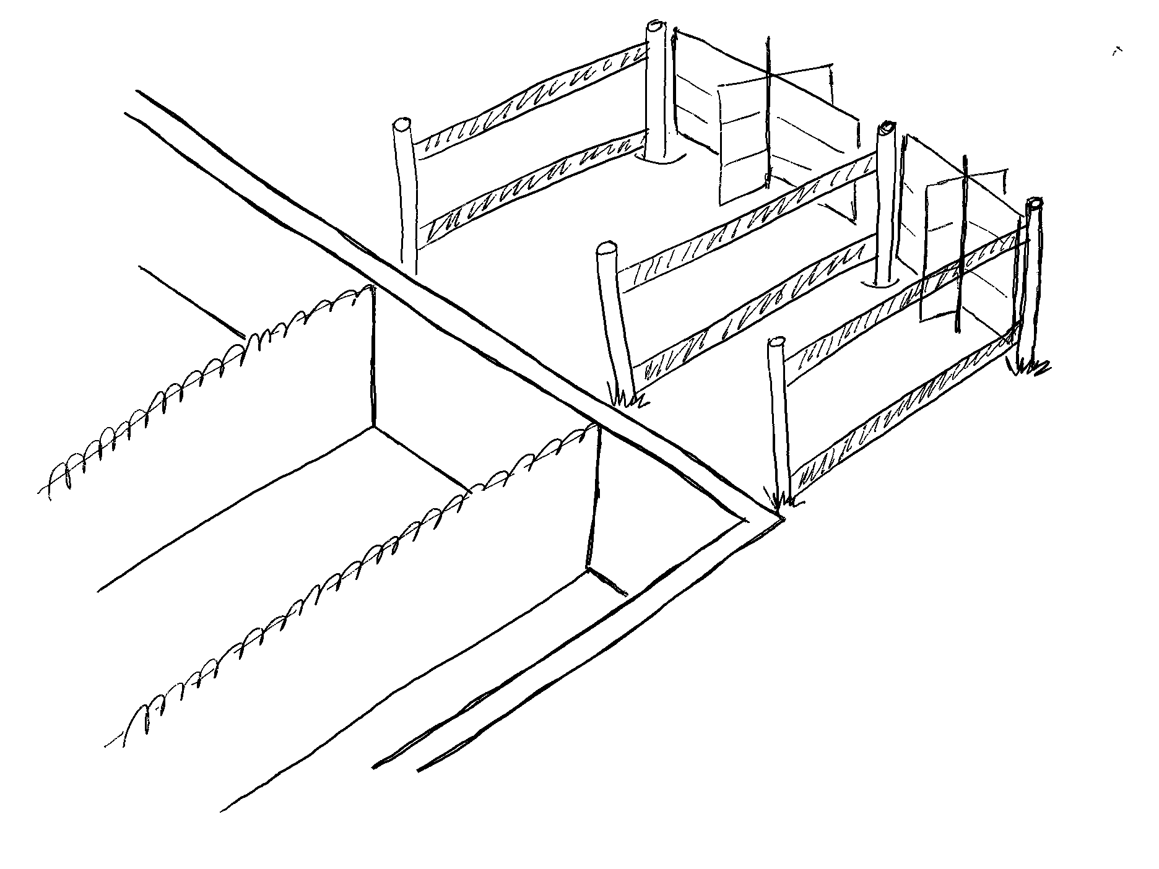
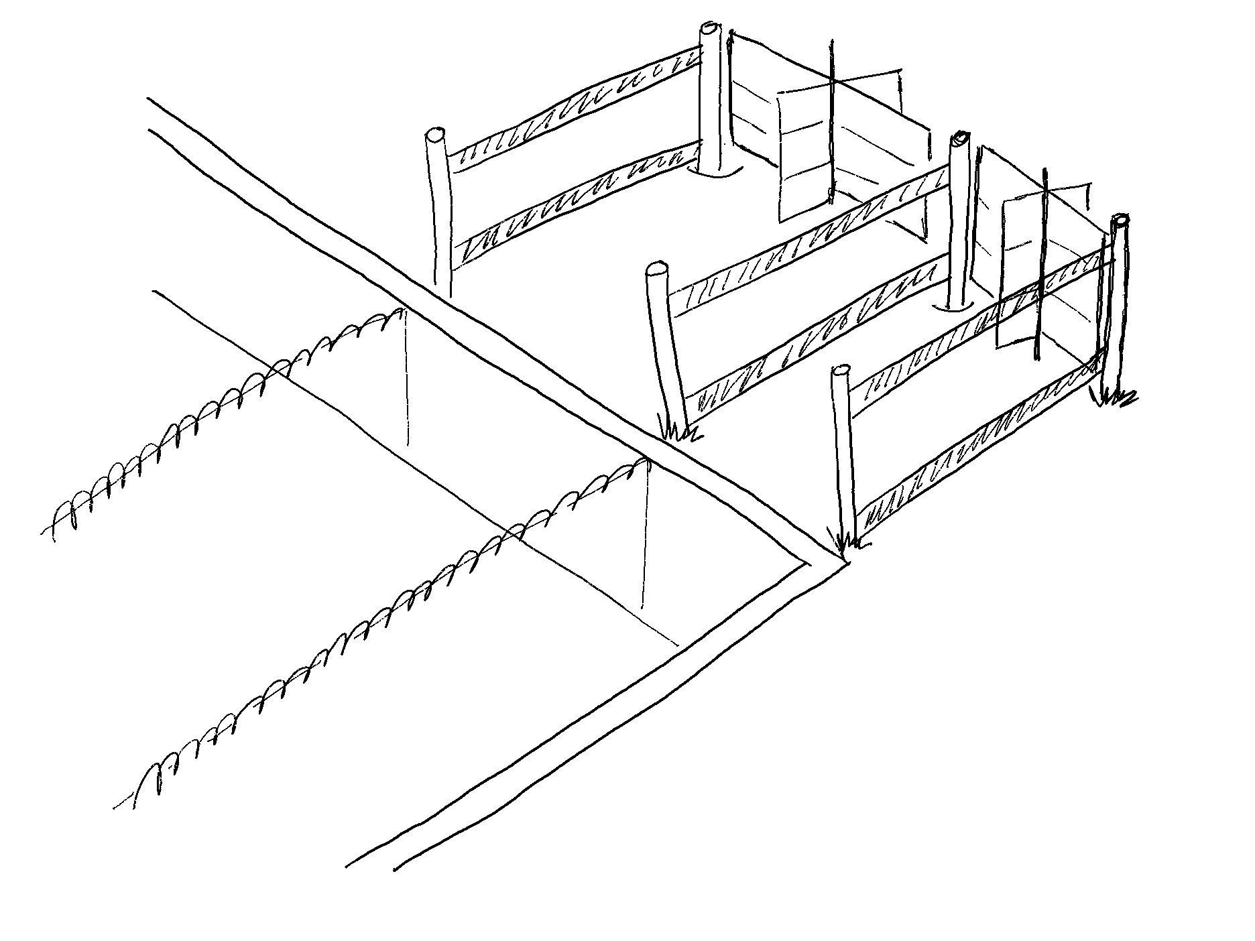
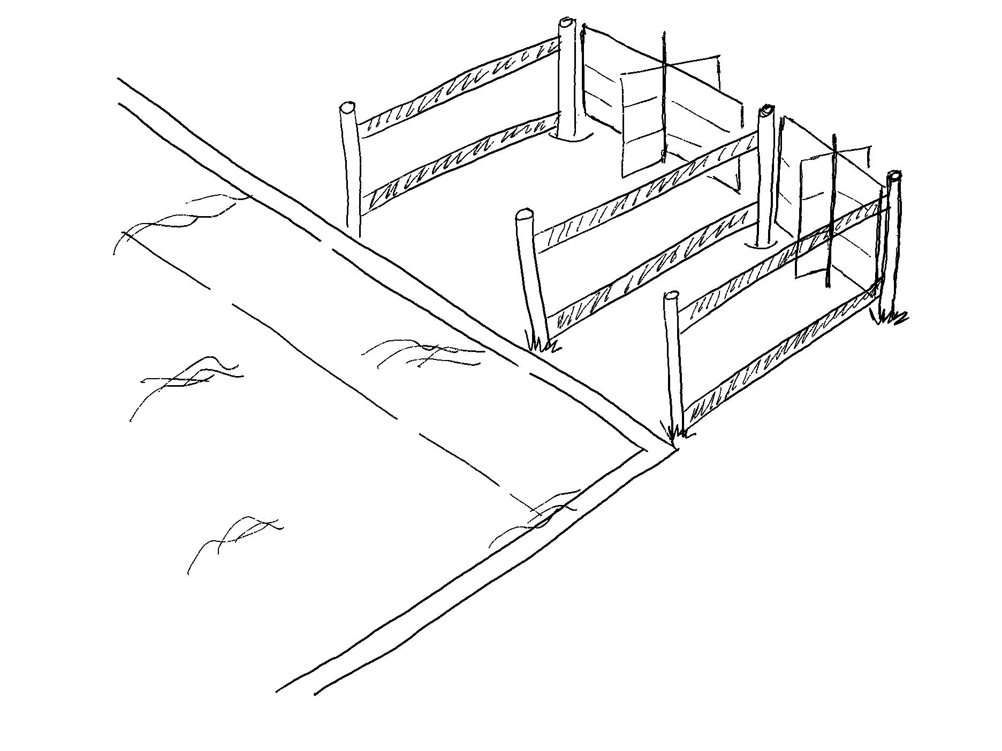
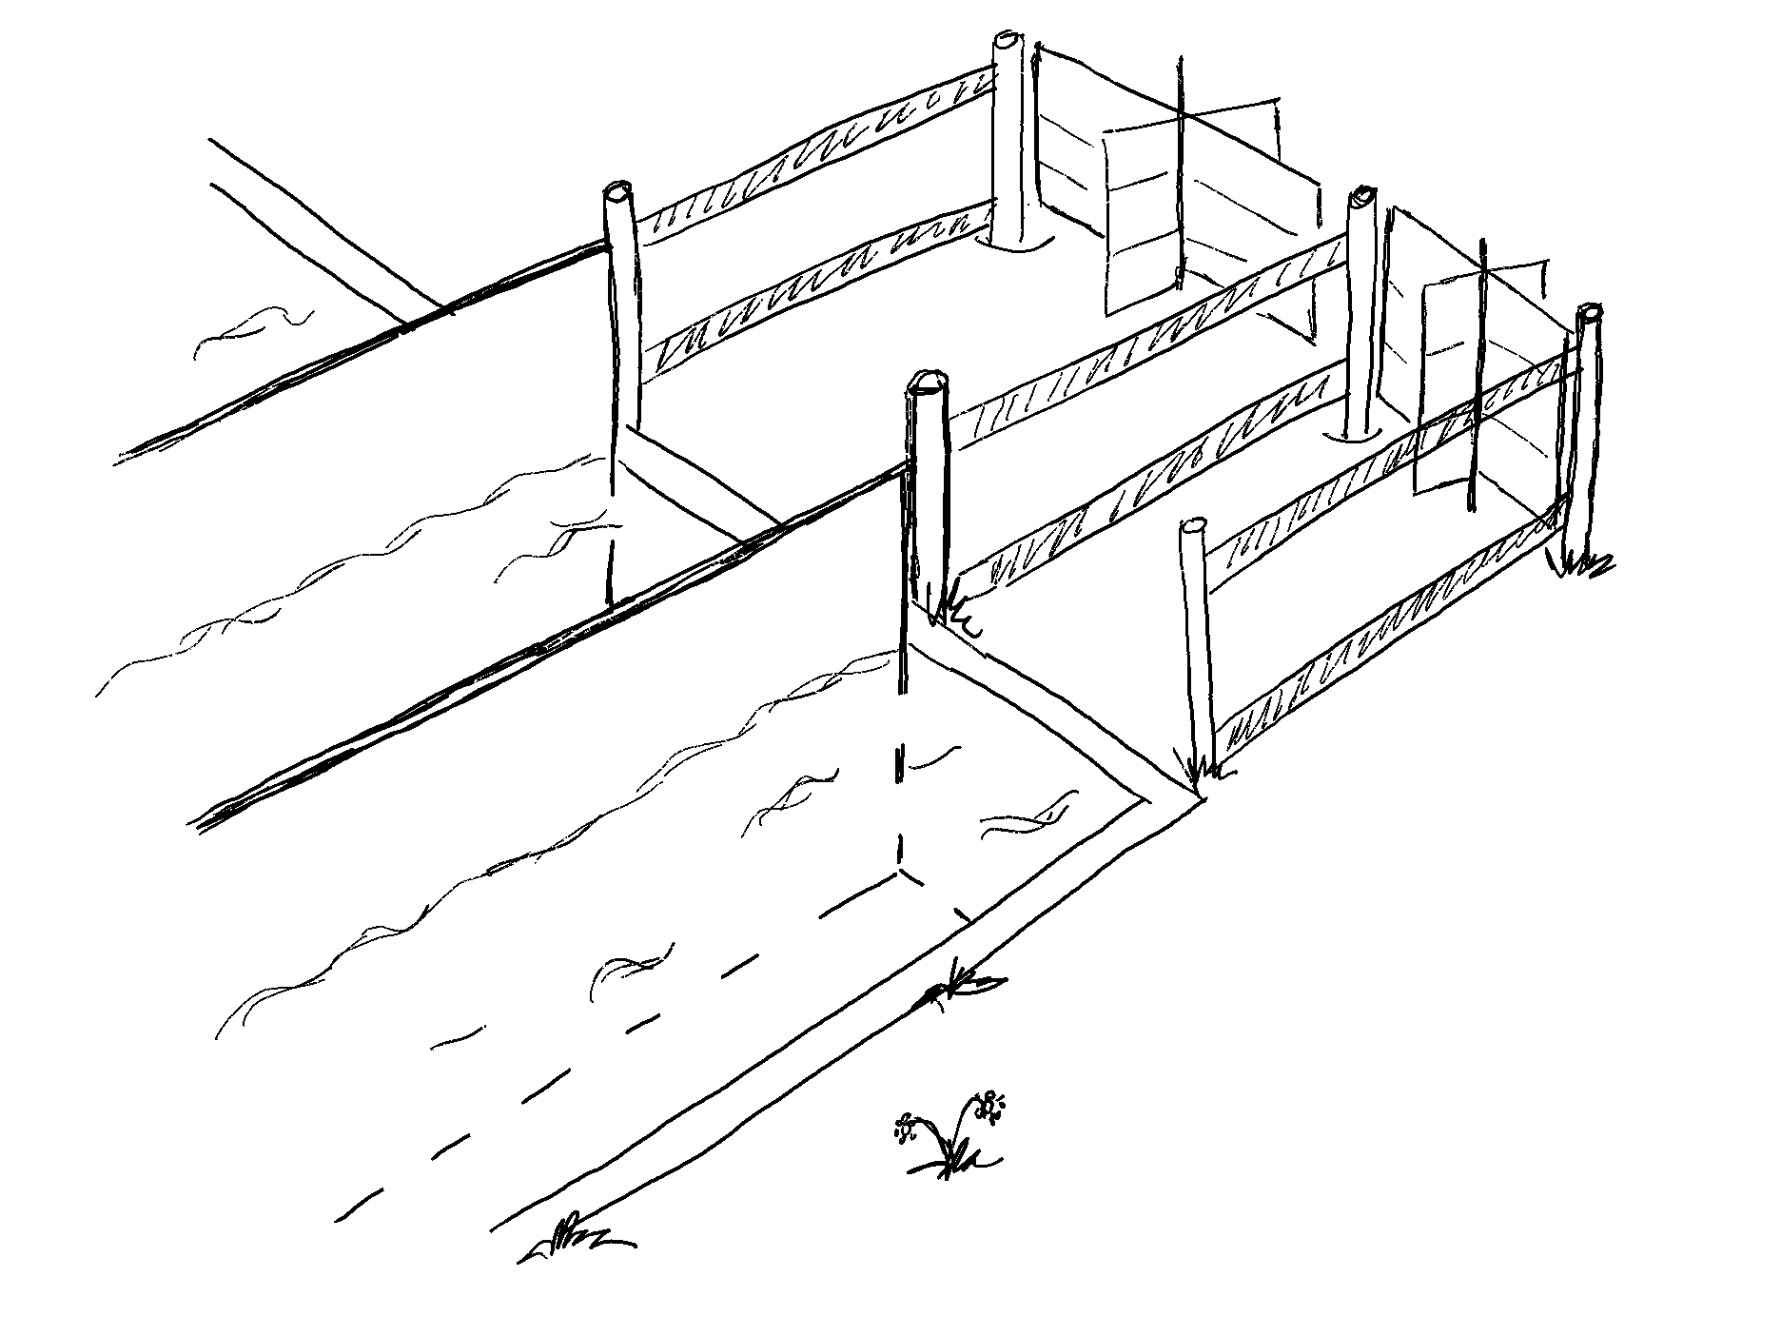
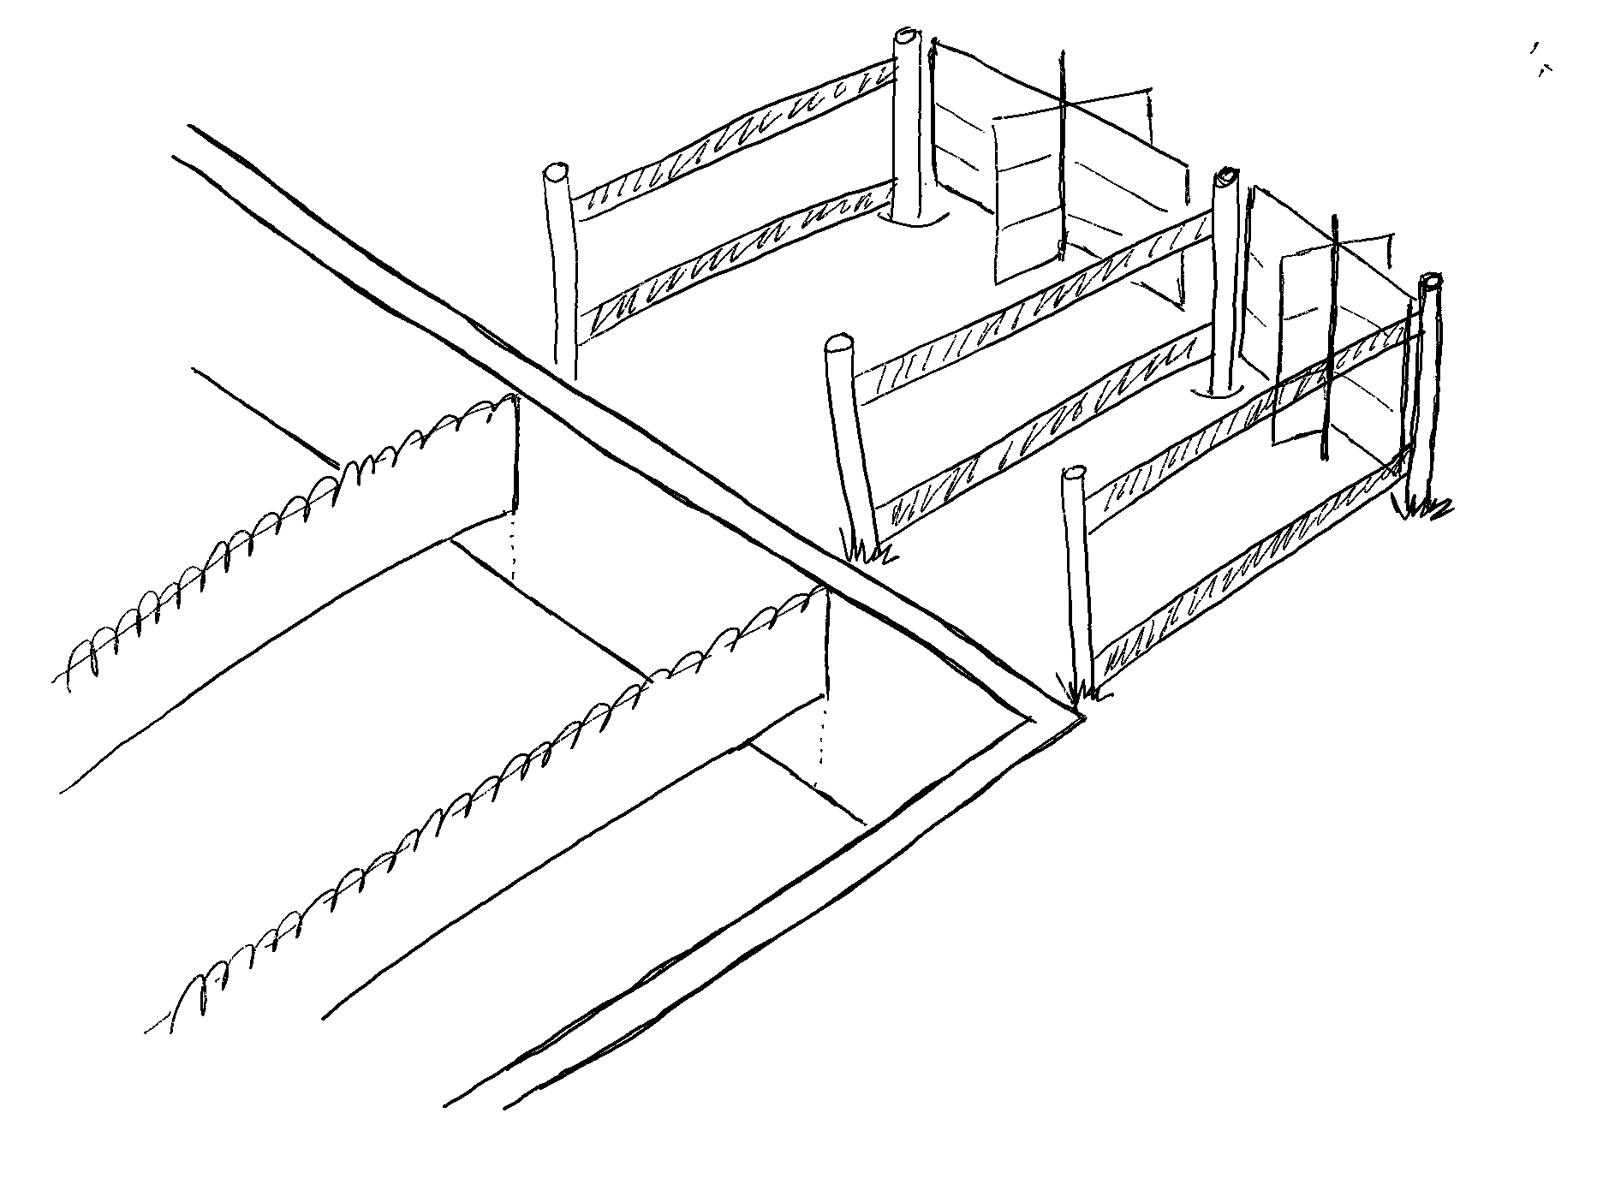
security of the service – public cloud shared: resources, responsibilities and security
secure vs. non-secure implementation
location in the EU
tenant isolation
access control (incl. metering)
logging / audit
(encryption)
…

Slide 16
agenda
What is the Cloud
IT Cloud Security Requirements
Security Risks

Slide 17
cloud service assessment list of risks (1/2)
Public
almost no sensitive data
Community
can contain sensitive data
data out of EU
common storage / bad neighbor
users not under control of CONSUMER (not managed by local IAM)
audit footprint missing (no audit logs)
access from managed devices almost not possible
audit footprint missing (business audit logs for compliance)
audit initiation complicated or not possible (internal/external audit)
documentation missing (security of the service not clear or missing)
much higher architecture complexity
sec. assessments obsolete or missing
communication channels to provider not set (broker)
vendor selection / early phase stage involvement

Slide 18
cloud service assessment list of risks (2/2)
Public
almost no sensitive data
Community
can contain sensitive data
data out of EU
common storage / bad neighbor
users not under control of CONSUMER (not managed by local IAM)
audit footprint missing (no audit logs)
access from managed devices almost not possible
common tenant (single tenant multi user)
regulator guidelines violation for transaction data (fin)
encryption out of the control (tenant wide setup)
invisible tenant wide/system setup (no view for community member)
no view/audit of the changes in the tenant or polices setup
misconfigurations -> sec. incidents
broker (tenant admin) dependency (too long loop, misunderstandings)
service quality degradation - API unavailable (API key on tenant level, no/restricted integration possibilities)
time / price
exit procedure

Slide 19
conclusion
cloud is not the enemy
banks would like to use clouds
in the same time they must to keep rules
cloud standards (internal / external)
security standards (internal / external)
legislation
not all clouds are secure enough (keep assessments)
security evaluation
quality of the service (availability, SLA, flexibility, exit)
some risks are acceptable, but must be monitored

Slide 20
Thank you

