Slide 1
Kaspersky
Threat Intelligence
Services pro vaše organizace
Vladimír Váňa, Territory Channel Manager, Kaspersky

Slide 2

Facts about us
> 22
years of history
> 4,000
highly qualified specialists
> 400,000,000
users worldwide are protected
by our technologies
> 270,000
corporate clients worldwide

Slide 3
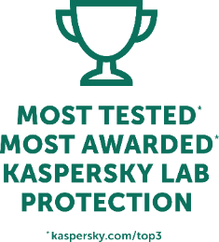





Most tested. Most awarded. Kaspersky Lab protection.*
In 2018 Kaspersky Lab products participated in 88 independent tests and reviews. Our products were awarded 73 firsts and received 77 top-three finishes.
Score of TOP 3 places
Kaspersky Lab
1st places – 73
Participated in 88
tests/reviews
TOP 3 = 88%
ESET
Bitdefender
AVG
Avast
Symantec
* Notes:
According to summary results of independent tests in 2018 for corporate, consumer and mobile products.
Summary includes independent tests conducted by: AV-Comparatives, AV-Test, SE Labs, MRG-Effitas, Virus Bulletin, ICSA Labs, PCSL, NSS Labs.
Tests performed in these programs assess all protection technologies against known, unknown and advanced threats.
The size of the bubble reflects the number of 1st places achieved.
Avira
G Data
McAfee
Trend Micro
F-Secure
Microsoft
No. of independent tests/reviews
© 2019 Kaspersky Lab. All rights reserved. Registered trademarks and service marks are the property of their respective owners.

Slide 4

Nature of the threats
Advanced persistent threats
Cyber-weapons................................................. 0,1% ..........
Targeted attacks
Targeted threats to organisations......9,9% ....................
€
Traditional cybercrime........... 90%......................................
10

Slide 5
Our contribution to the fight against advanced cyber threats
Thanks to our unique technologies and expertise, we detect 346,000 new malicious files every day.
Kaspersky’s Global Research and Analysis team (GReAT) is well-known for discovery and dissemination of the most advanced cyber threats. According to their data, in 2018 the top targets for Advanced Persistent Threats (APT) were governments, and the most significant threat actor was Sofacy.
Top 10 targets:
Government
Diplomatic
Energy
Military
Telecommunications
Financial institutions
IT companies
Military contractors
Political parties
NGOs
Top 10 targeted countries:
Top 10 APT groups:
Mongolia
1
Saudi Arabia
Iran
Germany
Kazakhstan
Russia
China
Sofacy
Turla
Lazarus
DarkHotel
LuckyMouse
ScarCruft
APT10
StrongPity
SandCat
OceanLotus
2
3
4
5
6
South Korea
India
Malaysia
7
8
9
10
apt.securelist.com

Slide 6
























Kaspersky major discoveries
Duqu 2.0
Metel
2010
Stuxnet
TeamSpy
Darkhotel
- part 2
ProjectSauron
Darkhotel
Naikon
Adwind
StoneDrill
2011
Duqu
Miniduke
MsnMM
Campaigns
Saguaro
Shamoon 2.0
CosmicDuke
Hellsing
Lazarus
BlueNoroff
RedOctober
Satellite
Turla
StrongPity
WannaCry
Gauss
Regin
Sofacy
Lurk
ExPetr/NotPetya
2012
Flame
2013
Icefog
2014
2015
2016
2017
Careto / The Mask
Carbanak
GCMan
ATMitch
miniFlame
Winnti
Wild
Neutron
Ghoul
Moonlight Maze
Epic Turla
Desert Falcons
Poseidon
ShadowPad
NetTraveler
Blue
Termite
Fruity Armor
WhiteBear
Energetic Bear / Crouching Yeti
Equation
Danti
BlackOasis
Kimsuky
Spring
Dragon
ScarCruft
Silence
Animal
Farm
Dropping Elephant
https://apt.securelist.com

Slide 7

Security Operations Center
?

Slide 8
Four key
elements
of the Security Operations Center
Prevent
Detect
Predict
Respond

Slide 9
Kaspersky
Threat Data Feeds

Slide 10

Kaspersky
Threat Data Feeds
IP REPUTATION
HASH FEED (WIN / *nix / MacOS / AndroidOS / iOS)
URL FEEDS (Malicious, Phishing and C&C)
Firewall
Proxy servers
Cloud server
RANSOMWARE URL FEED
APT IOC FEEDS
VULNERABILITY FEED
Kaspersky
Threat Data Feeds
SIEM/TIP
Endpoints
PASSIVE DNS (pDNS) FEED
IoT URL FEED
WHITELISTING FEED
Data center
DLP
Email servers
Notes:
Kaspersky Threat Intelligence also allows customers who, for whatever reason, don’t use our products to
benefit from our unique expertise and knowledge of cyber threats.
Continuously updated Threat Data Feeds contain threat indicators with additional context for the most dangerous and prevalent threats. They are provided in most widely used formats (JSON, STIX, OpenIOC, CSV etc.) with out-of-the-box integrations available for various security controls (leading SIEMs, Threat Intelligence Platforms, network security devices etc), empowering customers to mitigate cyberthreats more effectively and defend against attacks even before they are launched.
Rich context supplied for each of the threats (threat category and risk scoring, time stamps, popularity, WHOIS information etc.) helps security officers to prioritize the alert and categorize it to define the corresponding response process. Kaspersky Threat Data Feeds can be integrated into any SIEM and work alongside any APT solution.

Slide 11
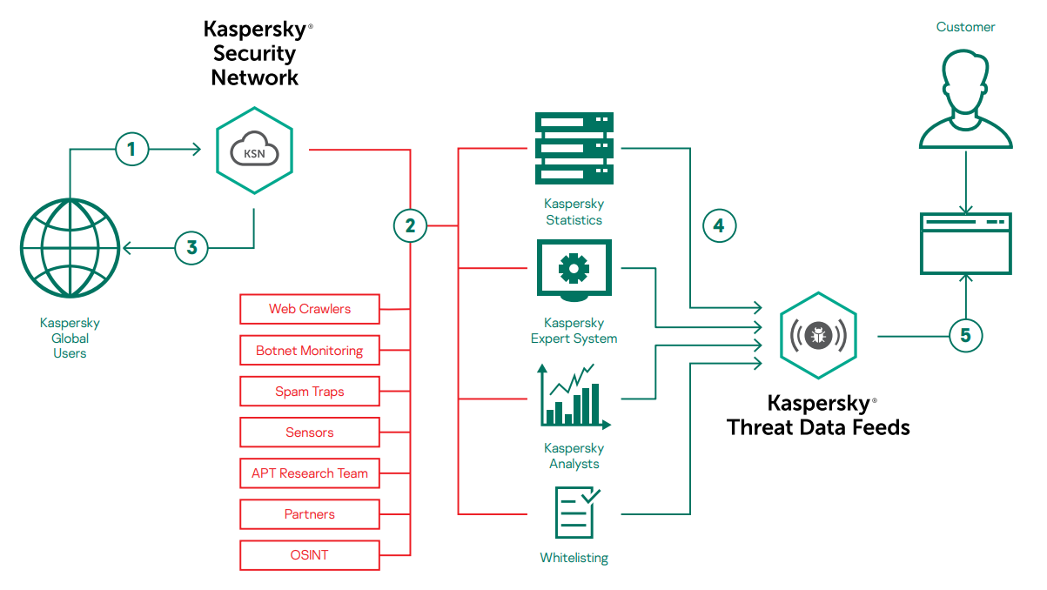
Notes:
Kaspersky Threat Intelligence also allows customers who, for whatever reason, don’t use our products to
benefit from our unique expertise and knowledge of cyber threats.
Continuously updated Threat Data Feeds contain threat indicators with additional context for the most dangerous and prevalent threats. They are provided in most widely used formats (JSON, STIX, OpenIOC, CSV etc.) with out-of-the-box integrations available for various security controls (leading SIEMs, Threat Intelligence Platforms, network security devices etc), empowering customers to mitigate cyberthreats more effectively and defend against attacks even before they are launched.
Rich context supplied for each of the threats (threat category and risk scoring, time stamps, popularity, WHOIS information etc.) helps security officers to prioritize the alert and categorize it to define the corresponding response process. Kaspersky Threat Data Feeds can be integrated into any SIEM and work alongside any APT solution.

Slide 12

Kaspersky
CyberTrace
SIEM aggregates logs from different network devices and IT systems and sends the events with URLs, hashes and IPs to the correlation service for analysis
CyberTrace rapidly matches incoming events with feeds and sends detected events to SIEM and CyberTrace Web
Forwarded events
Raw logs
Kaspersky
Threat Data Feeds,
commercial feeds,
OSINT feeds,
custom feeds
2
1
3
Detection events
Log sources
SIEM
CyberTrace
Internal feed sources
Dashboards
CyberTrace
Web
Views events with security context and receives alerts
Investigates security incidents based on context
Security Officer
4
Corporate network
Notes:
With enterprises increasingly falling victim to advanced and targeted attacks, it’s clear that a successful defense requires new methods. To protect themselves, businesses need to take a proactive approach, constantly adapting their security controls to the ever-changing threat environment. The only way to keep up with these changes is to build an effective threat intelligence program.
So how do you evaluate the numerous threat intelligence sources, identify the ones that are most relevant to your organization, and effectively operationalize them?
Kaspersky CyberTrace is a threat intelligence fusion and analysis tool that enables seamless integration of threat data feeds with security controls to help analysts to leverage threat intelligence in their existing security workflows more efficiently.
Here are some basic ideas that CyberTrace was based on and that make it different from the other solutions:
CyberTrace is flexible and can be easily integrated into the existing infrastructure which allows one to avoid the challenges of integrating threat intelligence feeds with SIEM solutions.
CyberTrace integrates with any threat intelligence feed you might want to use (threat intelligence feeds from Kaspersky, other vendors, OSINT or your custom feeds) and uses all these feeds together.
CyberTrace integrates with any security control you might want to use (firewalls, proxies) directly or via SIEM solution / Log Management solution, parses events from those security controls and match the extracted observables (URLs, hashes, IPs) against threat intelligence feeds.
CyberTrace does not reduce the performance of the existing security controls (threat intelligence can overload systems which are not built to process millions of threat indicators) and does not miss detections (threat indicators are often obfuscated and SIEM’s built-in matching logic is often ineffective).
CyberTrace helps to evaluate the effectiveness of the integrated threat intelligence feeds by providing detailed statistics on detections allowing analysts to compare different threat intelligence sources in terms of their relevance to the company.
By using CyberTrace, analysts can fight False Positives by whitelisting certain IoCs and filtering threat intelligence feeds according to configurable filtering rules.

Slide 13













Kaspersky Threat Data Feeds &
CyberTrace
Internet
DMZ Network
Miss configuration
or exclusions
Kaspersky
CyberTrace
Domains
Botnet C&C
URLs
Vulnerabilities
IP addresses
Hashes
Phising
Internal Network
188.215.229.11
SIEM

Slide 14
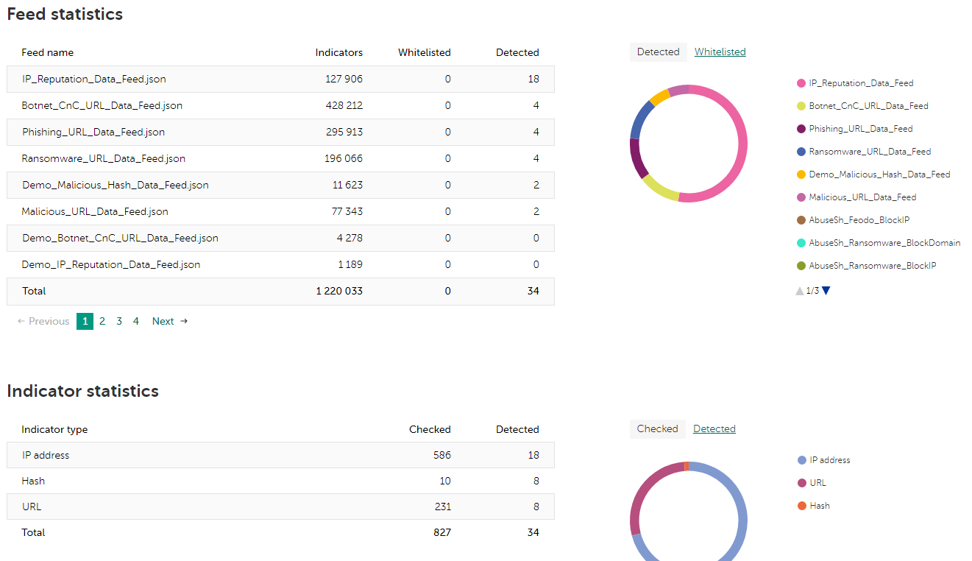
Notes:
Kaspersky Threat Intelligence also allows customers who, for whatever reason, don’t use our products to
benefit from our unique expertise and knowledge of cyber threats.
Continuously updated Threat Data Feeds contain threat indicators with additional context for the most dangerous and prevalent threats. They are provided in most widely used formats (JSON, STIX, OpenIOC, CSV etc.) with out-of-the-box integrations available for various security controls (leading SIEMs, Threat Intelligence Platforms, network security devices etc), empowering customers to mitigate cyberthreats more effectively and defend against attacks even before they are launched.
Rich context supplied for each of the threats (threat category and risk scoring, time stamps, popularity, WHOIS information etc.) helps security officers to prioritize the alert and categorize it to define the corresponding response process. Kaspersky Threat Data Feeds can be integrated into any SIEM and work alongside any APT solution.

Slide 15
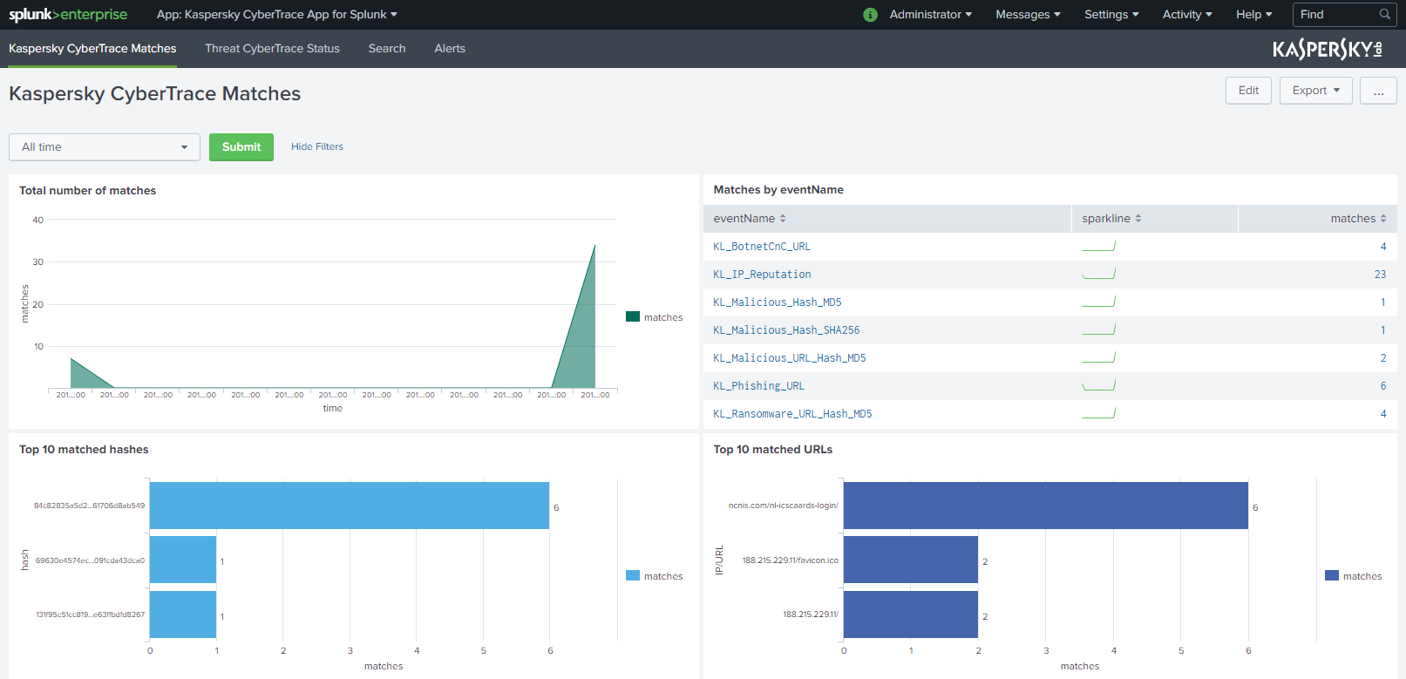
Notes:
Kaspersky Threat Intelligence also allows customers who, for whatever reason, don’t use our products to
benefit from our unique expertise and knowledge of cyber threats.
Continuously updated Threat Data Feeds contain threat indicators with additional context for the most dangerous and prevalent threats. They are provided in most widely used formats (JSON, STIX, OpenIOC, CSV etc.) with out-of-the-box integrations available for various security controls (leading SIEMs, Threat Intelligence Platforms, network security devices etc), empowering customers to mitigate cyberthreats more effectively and defend against attacks even before they are launched.
Rich context supplied for each of the threats (threat category and risk scoring, time stamps, popularity, WHOIS information etc.) helps security officers to prioritize the alert and categorize it to define the corresponding response process. Kaspersky Threat Data Feeds can be integrated into any SIEM and work alongside any APT solution.

Slide 16
188.215.229.11
?

Slide 17
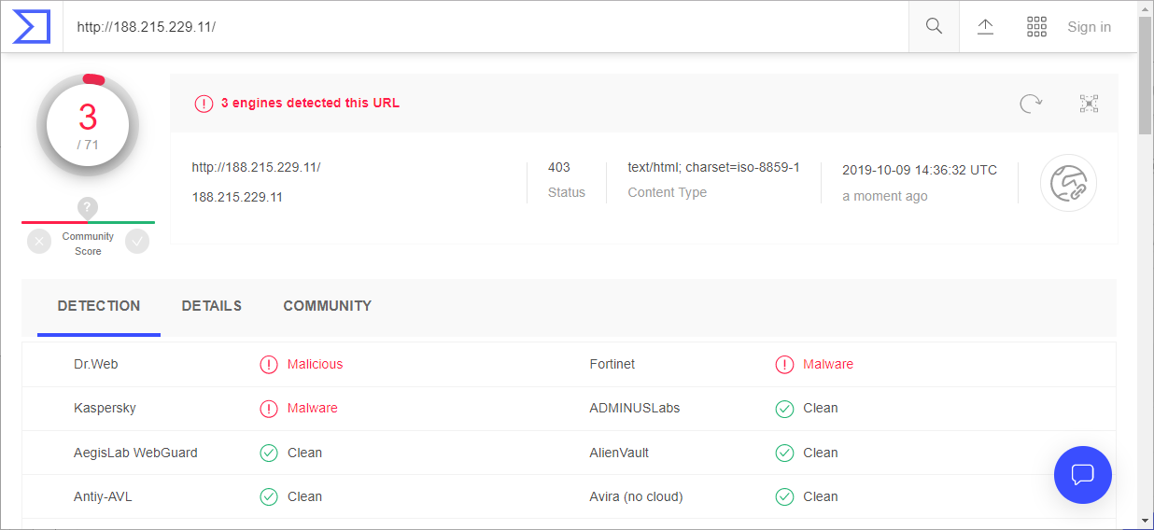
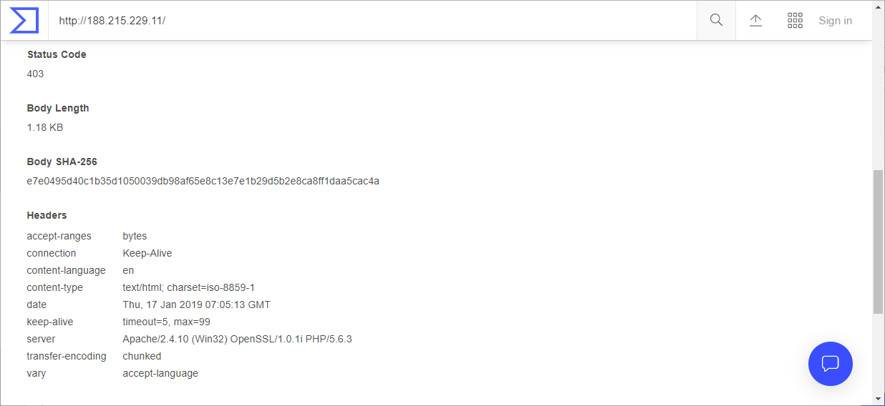
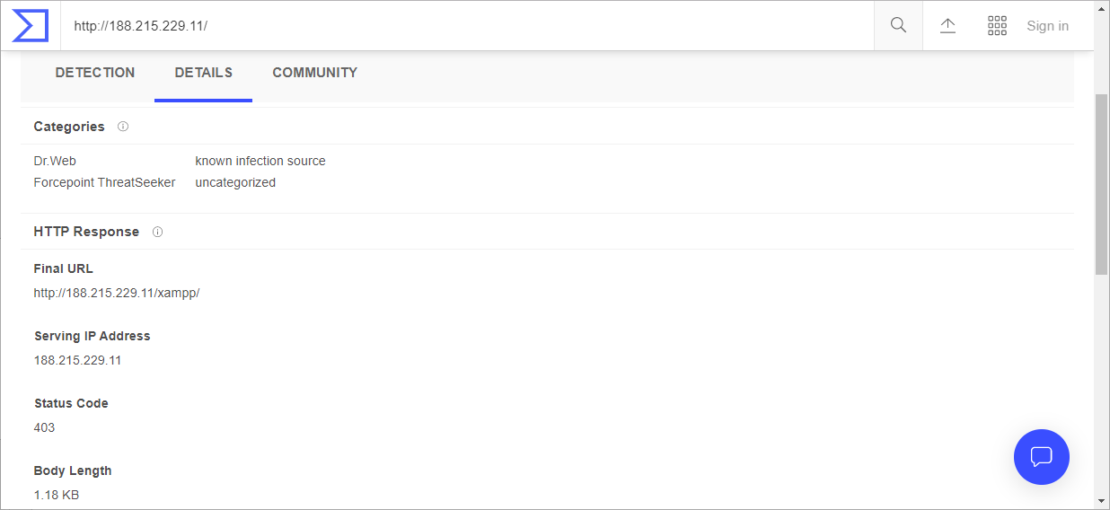
VirusTotal aggregate
Notes:
Kaspersky Threat Intelligence also allows customers who, for whatever reason, don’t use our products to
benefit from our unique expertise and knowledge of cyber threats.
Continuously updated Threat Data Feeds contain threat indicators with additional context for the most dangerous and prevalent threats. They are provided in most widely used formats (JSON, STIX, OpenIOC, CSV etc.) with out-of-the-box integrations available for various security controls (leading SIEMs, Threat Intelligence Platforms, network security devices etc), empowering customers to mitigate cyberthreats more effectively and defend against attacks even before they are launched.
Rich context supplied for each of the threats (threat category and risk scoring, time stamps, popularity, WHOIS information etc.) helps security officers to prioritize the alert and categorize it to define the corresponding response process. Kaspersky Threat Data Feeds can be integrated into any SIEM and work alongside any APT solution.

Slide 18
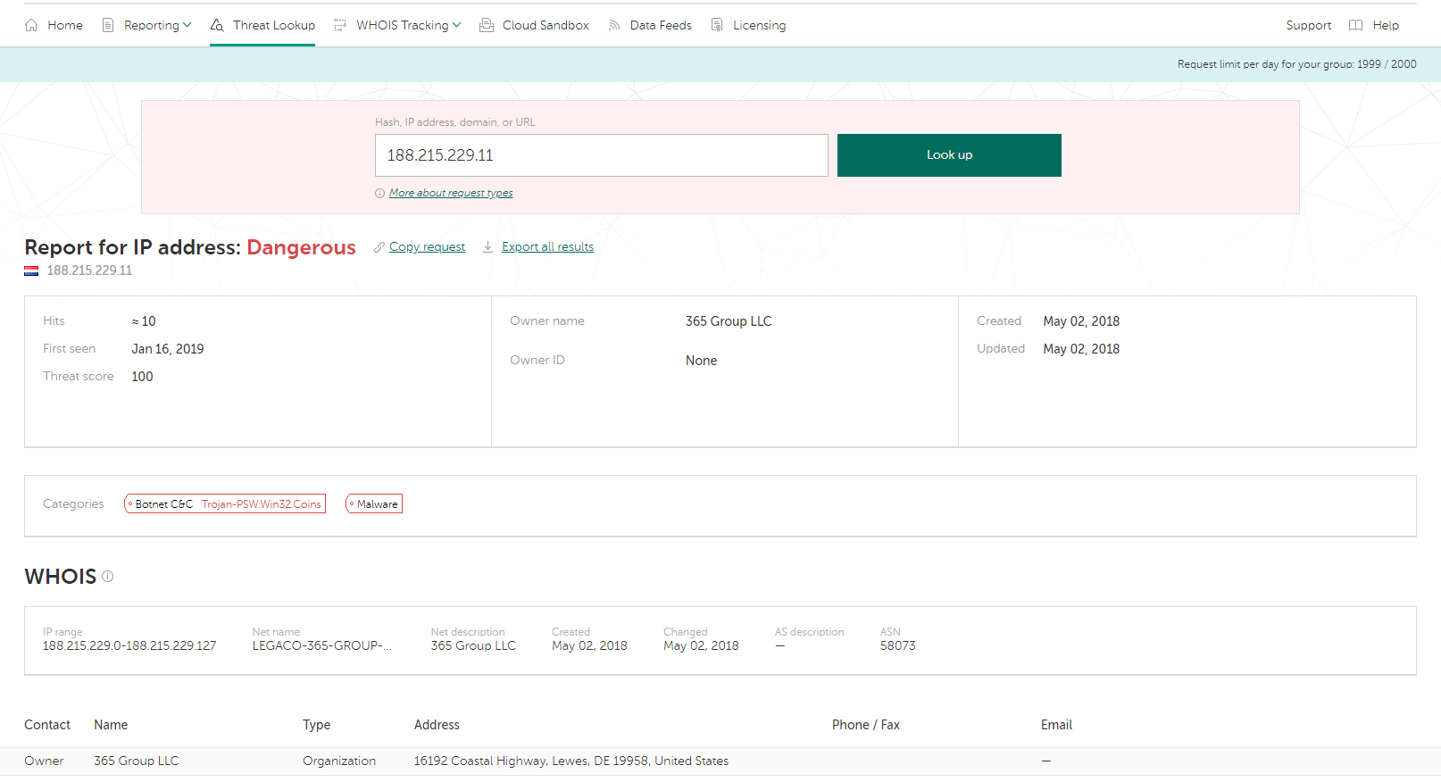
Kaspersky Threat Intelligence Portal
Notes:
Kaspersky Threat Intelligence also allows customers who, for whatever reason, don’t use our products to
benefit from our unique expertise and knowledge of cyber threats.
Continuously updated Threat Data Feeds contain threat indicators with additional context for the most dangerous and prevalent threats. They are provided in most widely used formats (JSON, STIX, OpenIOC, CSV etc.) with out-of-the-box integrations available for various security controls (leading SIEMs, Threat Intelligence Platforms, network security devices etc), empowering customers to mitigate cyberthreats more effectively and defend against attacks even before they are launched.
Rich context supplied for each of the threats (threat category and risk scoring, time stamps, popularity, WHOIS information etc.) helps security officers to prioritize the alert and categorize it to define the corresponding response process. Kaspersky Threat Data Feeds can be integrated into any SIEM and work alongside any APT solution.

Slide 19
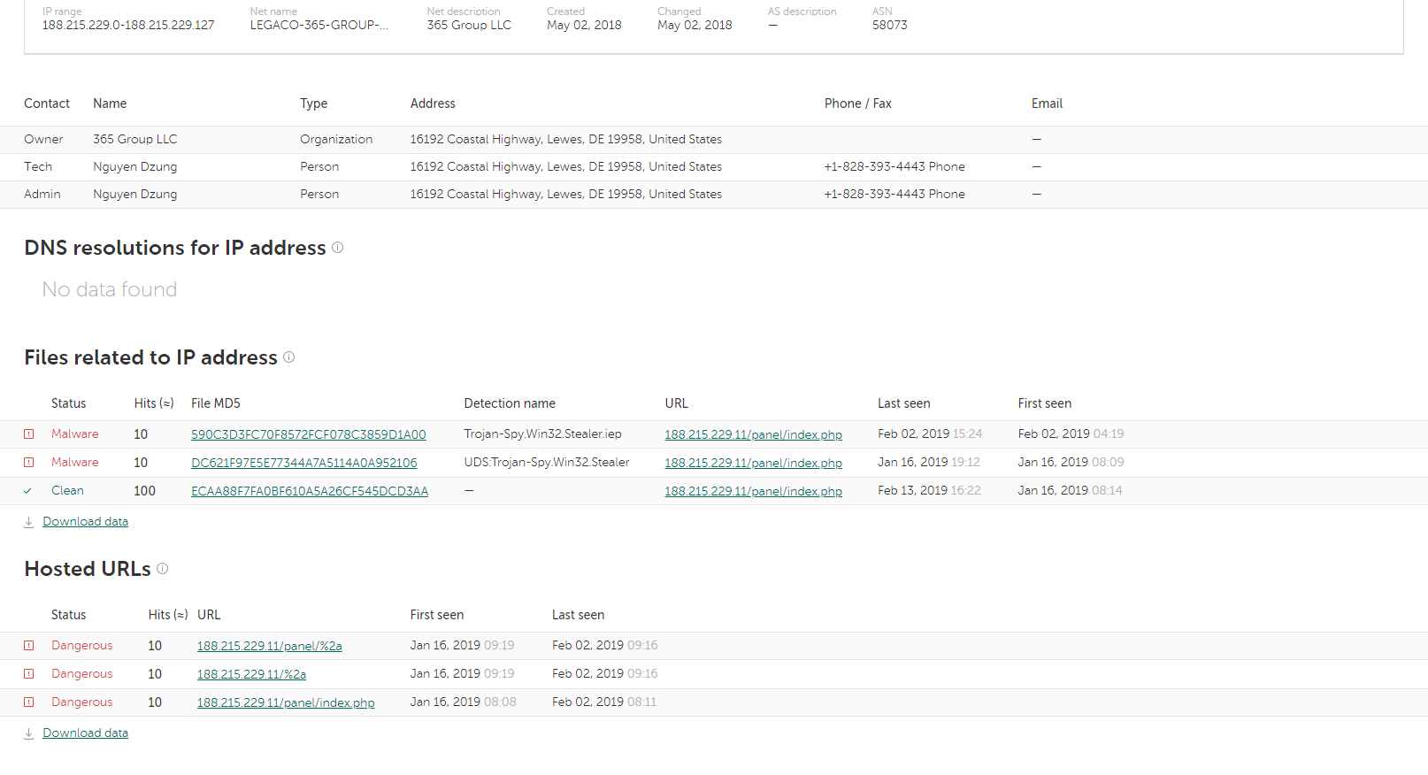
Kaspersky Threat Intelligence Portal
Notes:
Kaspersky Threat Intelligence also allows customers who, for whatever reason, don’t use our products to
benefit from our unique expertise and knowledge of cyber threats.
Continuously updated Threat Data Feeds contain threat indicators with additional context for the most dangerous and prevalent threats. They are provided in most widely used formats (JSON, STIX, OpenIOC, CSV etc.) with out-of-the-box integrations available for various security controls (leading SIEMs, Threat Intelligence Platforms, network security devices etc), empowering customers to mitigate cyberthreats more effectively and defend against attacks even before they are launched.
Rich context supplied for each of the threats (threat category and risk scoring, time stamps, popularity, WHOIS information etc.) helps security officers to prioritize the alert and categorize it to define the corresponding response process. Kaspersky Threat Data Feeds can be integrated into any SIEM and work alongside any APT solution.

Slide 20
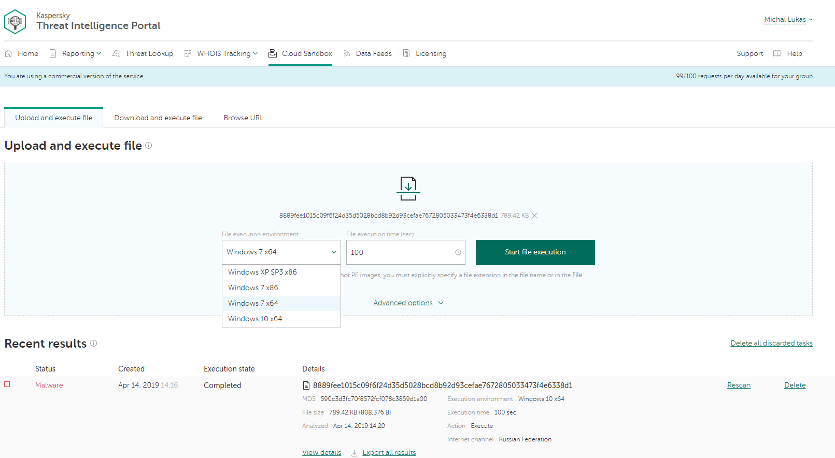
Kaspersky Threat Intelligence Portal
Notes:
Kaspersky Threat Intelligence also allows customers who, for whatever reason, don’t use our products to
benefit from our unique expertise and knowledge of cyber threats.
Continuously updated Threat Data Feeds contain threat indicators with additional context for the most dangerous and prevalent threats. They are provided in most widely used formats (JSON, STIX, OpenIOC, CSV etc.) with out-of-the-box integrations available for various security controls (leading SIEMs, Threat Intelligence Platforms, network security devices etc), empowering customers to mitigate cyberthreats more effectively and defend against attacks even before they are launched.
Rich context supplied for each of the threats (threat category and risk scoring, time stamps, popularity, WHOIS information etc.) helps security officers to prioritize the alert and categorize it to define the corresponding response process. Kaspersky Threat Data Feeds can be integrated into any SIEM and work alongside any APT solution.

Slide 21
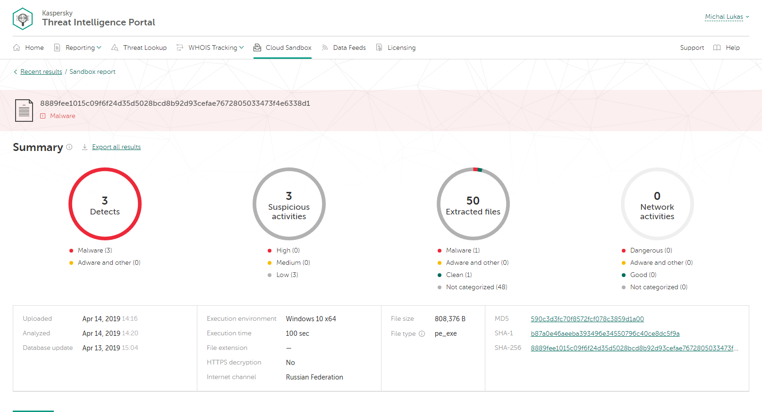
Kaspersky Threat Intelligence Portal
Notes:
Kaspersky Threat Intelligence also allows customers who, for whatever reason, don’t use our products to
benefit from our unique expertise and knowledge of cyber threats.
Continuously updated Threat Data Feeds contain threat indicators with additional context for the most dangerous and prevalent threats. They are provided in most widely used formats (JSON, STIX, OpenIOC, CSV etc.) with out-of-the-box integrations available for various security controls (leading SIEMs, Threat Intelligence Platforms, network security devices etc), empowering customers to mitigate cyberthreats more effectively and defend against attacks even before they are launched.
Rich context supplied for each of the threats (threat category and risk scoring, time stamps, popularity, WHOIS information etc.) helps security officers to prioritize the alert and categorize it to define the corresponding response process. Kaspersky Threat Data Feeds can be integrated into any SIEM and work alongside any APT solution.

Slide 22
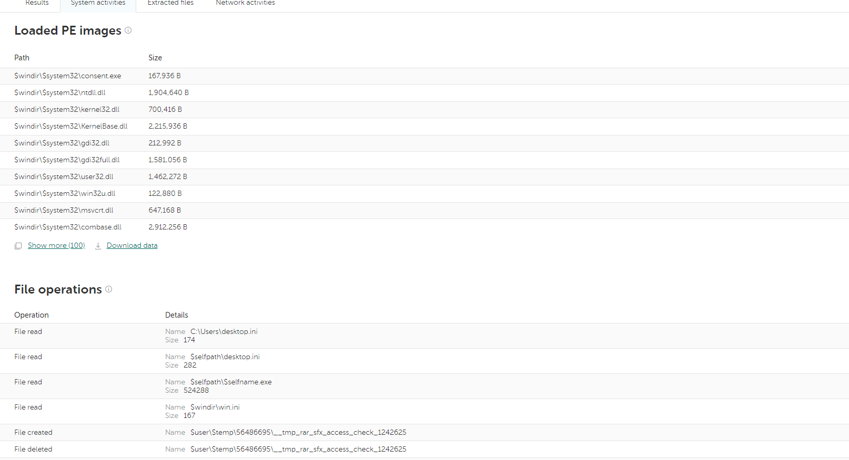
Kaspersky Threat Intelligence Portal
Notes:
Kaspersky Threat Intelligence also allows customers who, for whatever reason, don’t use our products to
benefit from our unique expertise and knowledge of cyber threats.
Continuously updated Threat Data Feeds contain threat indicators with additional context for the most dangerous and prevalent threats. They are provided in most widely used formats (JSON, STIX, OpenIOC, CSV etc.) with out-of-the-box integrations available for various security controls (leading SIEMs, Threat Intelligence Platforms, network security devices etc), empowering customers to mitigate cyberthreats more effectively and defend against attacks even before they are launched.
Rich context supplied for each of the threats (threat category and risk scoring, time stamps, popularity, WHOIS information etc.) helps security officers to prioritize the alert and categorize it to define the corresponding response process. Kaspersky Threat Data Feeds can be integrated into any SIEM and work alongside any APT solution.

Slide 23
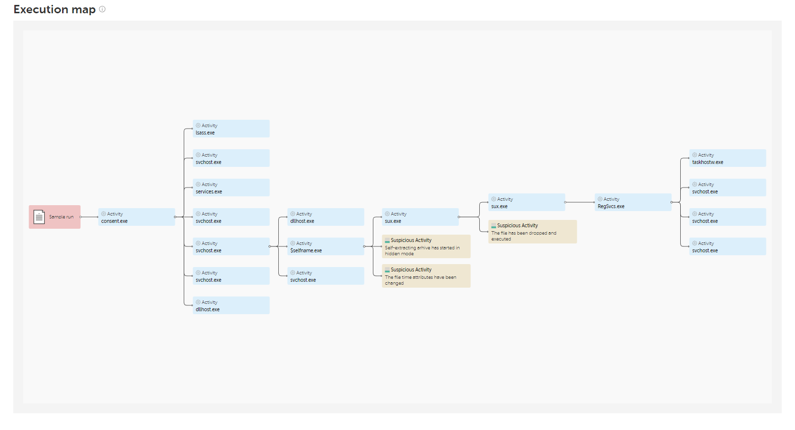
Kaspersky Threat Intelligence Portal
Notes:
Kaspersky Threat Intelligence also allows customers who, for whatever reason, don’t use our products to
benefit from our unique expertise and knowledge of cyber threats.
Continuously updated Threat Data Feeds contain threat indicators with additional context for the most dangerous and prevalent threats. They are provided in most widely used formats (JSON, STIX, OpenIOC, CSV etc.) with out-of-the-box integrations available for various security controls (leading SIEMs, Threat Intelligence Platforms, network security devices etc), empowering customers to mitigate cyberthreats more effectively and defend against attacks even before they are launched.
Rich context supplied for each of the threats (threat category and risk scoring, time stamps, popularity, WHOIS information etc.) helps security officers to prioritize the alert and categorize it to define the corresponding response process. Kaspersky Threat Data Feeds can be integrated into any SIEM and work alongside any APT solution.

Slide 24
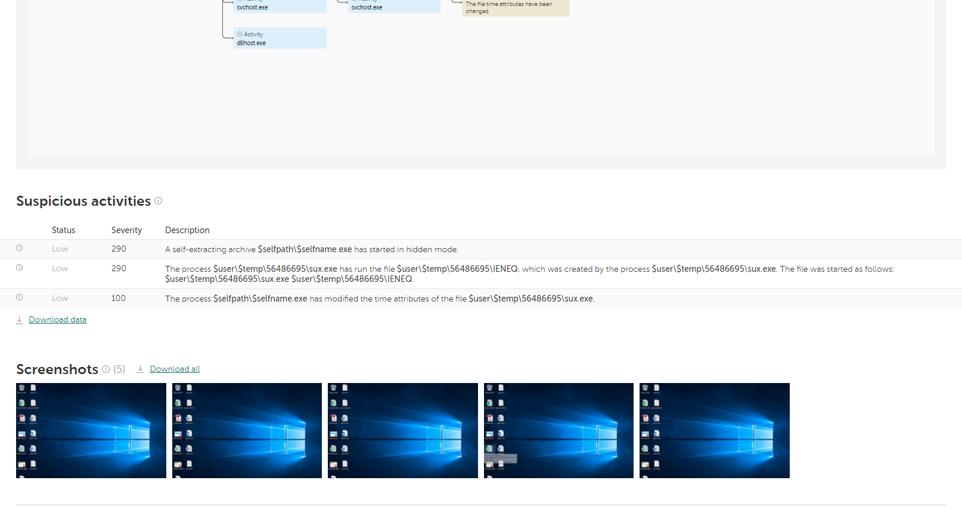
Kaspersky Threat Intelligence Portal
Notes:
Kaspersky Threat Intelligence also allows customers who, for whatever reason, don’t use our products to
benefit from our unique expertise and knowledge of cyber threats.
Continuously updated Threat Data Feeds contain threat indicators with additional context for the most dangerous and prevalent threats. They are provided in most widely used formats (JSON, STIX, OpenIOC, CSV etc.) with out-of-the-box integrations available for various security controls (leading SIEMs, Threat Intelligence Platforms, network security devices etc), empowering customers to mitigate cyberthreats more effectively and defend against attacks even before they are launched.
Rich context supplied for each of the threats (threat category and risk scoring, time stamps, popularity, WHOIS information etc.) helps security officers to prioritize the alert and categorize it to define the corresponding response process. Kaspersky Threat Data Feeds can be integrated into any SIEM and work alongside any APT solution.

Slide 25
Summary
> Detected infected machine in corporate network
only from log sources
> Analyzing of infected detection
communication with Botnet C&C, hashes and URLs
> Incident Respond
scan all of the machines, all infected host isolate from the corporate network
> Prevention
block IP address and URLs on firewall, block files based on hashes by application control for servers and workstations

Slide 26
Four key
elements
of the Security Operations Center
> Detected infected machine in corporate network
only from log sources
> Analyzing of infected detection
communication with Botnet C&C, hashes and URLs
> Incident Respond
scan all of the machines, all infected host isolate from the corporate network
> Prevention
block IP address and URLs on firewall, block files based on hashes by application control for servers and workstations
Prevent
Detect
Predict
Respond

Slide 27
Thank you!
Vladimír Váňa, Territory Channel Manager, Kaspersky

